Slide 1


Introduction to HTML & CSS
Instructor: Beck Johnson
Week 4

Slide 2

SESSION OVERVIEW
Review borders, inline/block, and class/id
Layout – floats and flex
Using web fonts
Responsive design

Slide 3

REVIEW!

Slide 4
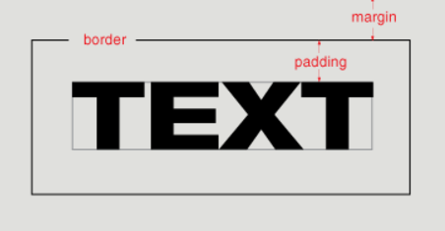
{ } css box model
Content: stuff in the box
Padding: space inside the box
Border: sides of the box
Margin: space between multiple boxes

Slide 5
{ } border
Between margin and padding, you can set a border
Width (usually in pixels)
Border style (solid, dotted, dashed, etc)
Color
p
border: 2px dotted #ff0000;
}

Slide 6
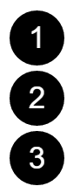
{ } border-radius
To make an element appear curved, use the property border-radius
The value is a number (in px or em) or percentage
You can use border-radius even if you don’t explicitly set a border
li {
border-radius: 50%;
height: 3em;
width: 3em;
}

Slide 7
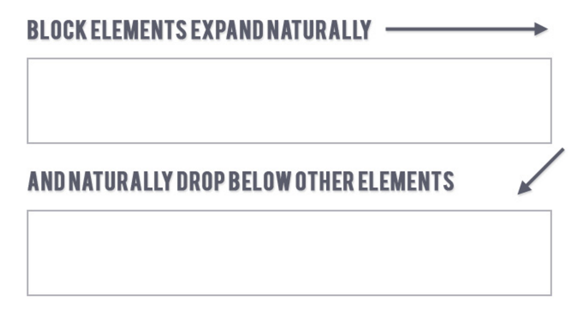
{ } block elements
Block elements
Expand naturally to fill their parent container
Take up a full line
Can have margin and/or padding

Slide 8
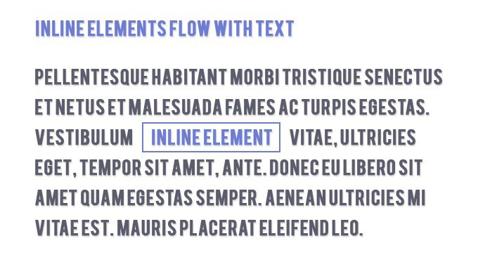
{ } inline elements
inline elements
Flow along with text content
Ignores top and bottom margin/padding
Honors left and right margin/padding

Slide 9
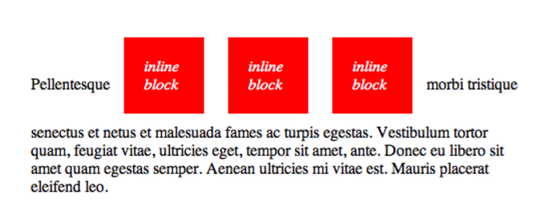
{ } inline-block elements
Inline-block elements
A hybrid of block and inline
Flow along with text content
Has height, width, margin, and padding

Slide 10
{} classes and ids
You can add class and id to any HTML element to identify it for styling.
You decide the class and id values – be descriptive!
<p class="important">Big text</p>
<p id="anyLettersOrNumbersOr_Or-">Still totally valid</p>

Slide 11
{} classes
Multiple elements can have the same class
<p class="muscles">Schwarzenegger</p>
<p class="muscles">The Rock</p>
In CSS, target a class with a period
.muscles { display: flex; }

Slide 12
{} ids
Only one element per page can use the same id
<div id="tower-of-pisa">There can be only one</div>
In CSS, target an id with a hash
#tower-of-pisa { font-style: italic; }
An id on an element lets you link to it directly using a link href starting with a #

Slide 13
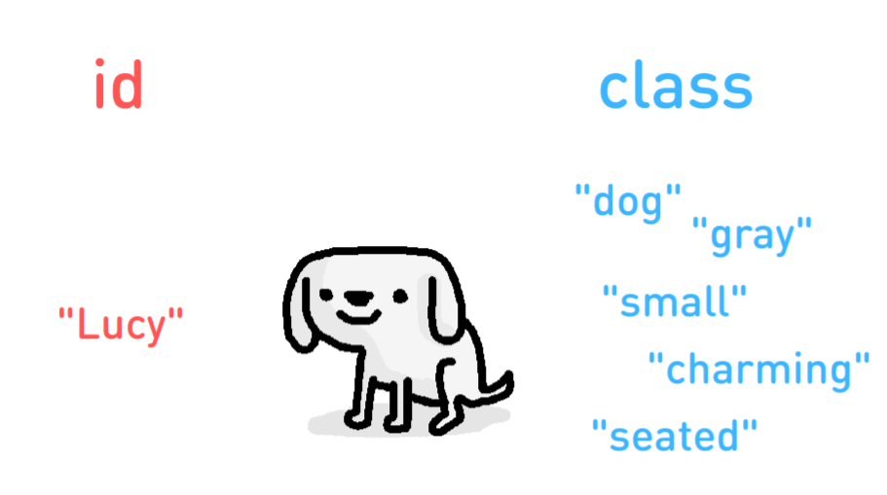
{} class vs id

Slide 14
QUESTIONS?

Slide 15

WEB LAYOUTS

Slide 16
WEB lAYOUTS
With CSS, we can use a variety of properties to arrange elements on the screen by adjusting the flow of the page.
Basically, you can put elements anywhere…which can be both a good and a bad thing!

Slide 17
3 web layout properties
display: dictates how elements behave within the box model
float: moves elements around within the page flow
position: takes elements entirely out of the page flow

Slide 18
Display property
The display property tells the browser what type of box model to use:
inline
inline-block
block
flex
This changes how padding, margin, height and width affect an element.
You also can set display: none to hide an element entirely.

Slide 19
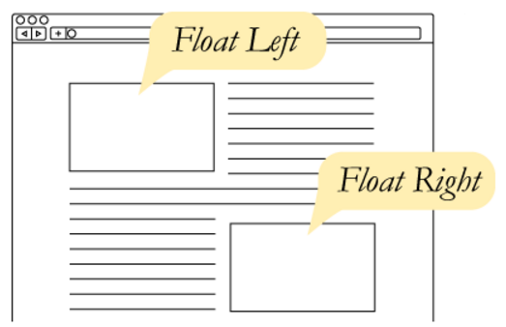
CSS Floats
Up to now, elements have displayed sequentially, in the order that you placed them in your HTML.
The float property takes an element out of the normal flow and “floats” it to the left or right side of its container.
This allows other content
to flow around it
img { float: left; }

Slide 20
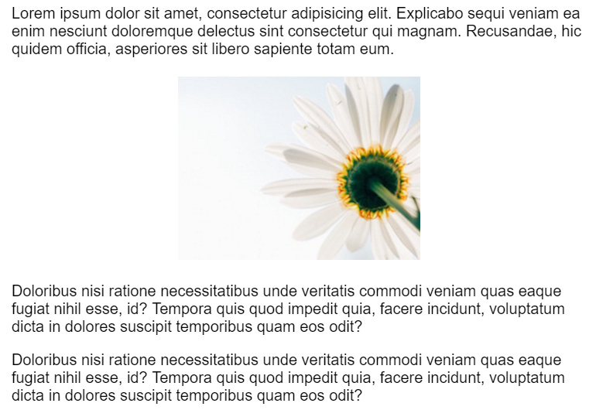
CSS Floats
The three values for float are:
left
right
none
By default, elements are float: none

Slide 21
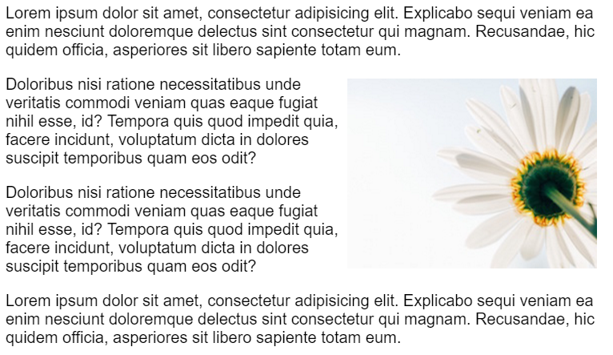
CSS Floats
img { float: right; }

Slide 22
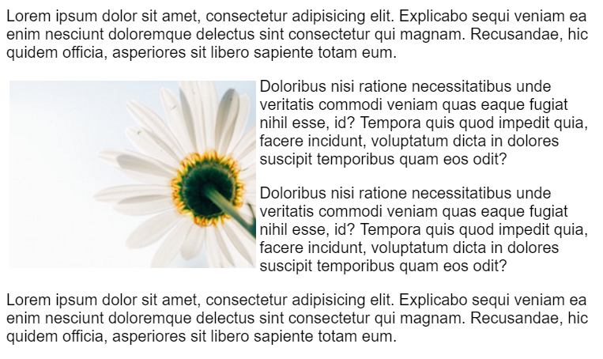
CSS Floats
img { float: left; }

Slide 23
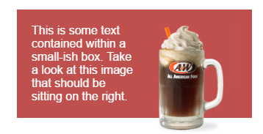
Flows before rows
Where you place your floated element in your HTML can cause different results.
Live demo here.
<div id="container">
<img src="rootbeer-float.png" style="float:right" />
<p>This is some text contained…</p>
</div>

Slide 24
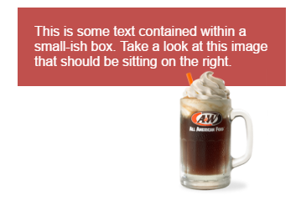
Flows before rows
What happens if we move the image below the paragraph?
<div id="container">
<p>This is some text contained…</p>
<img src="rootbeer-float.png" style="float: right" />
</div>
A general rule is float first.
Place floated elements before
any non-floated elements the
float interacts with

Slide 25
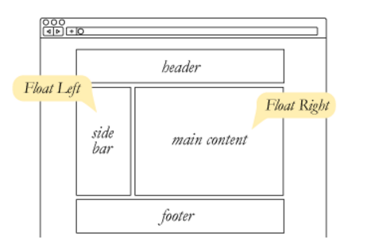
CSS Floats
float can be used to float text around images, but it also can be used to create entire page layouts.

Slide 26

CSS Floats
CSS Floats
For example, this layout was built using float.
<div>
<img class="avatar" src="beck.png" />
<h2 class="bio">By Beck Johnson</h2>
<p class="bio">Beck Johnson is… </p>
</div>

Slide 27
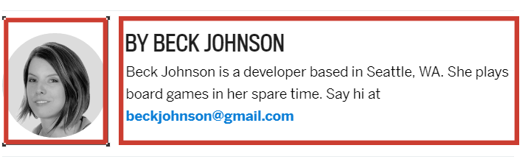
CSS Floats
CSS Floats
.avatar { float: left; }
.bio { float: right; }
Let’s try that…

Slide 28
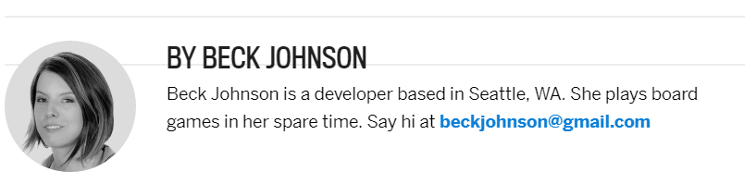
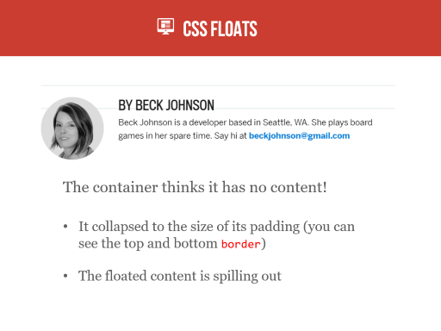
CSS Floats
CSS Floats
The container thinks it has no content!
It collapsed to the size of its padding (you can see the top and bottom border)
The floated content is spilling out

Slide 29
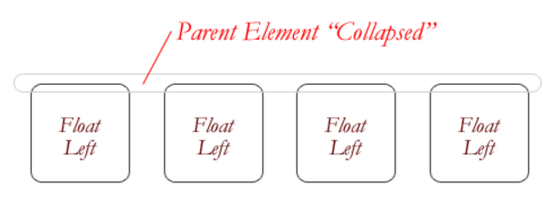
CSS Floats
CSS Floats
If you float an element, it is no longer in the normal document flow.
If all elements in a container are floated, that means that the container is effectively “empty.”

Slide 30
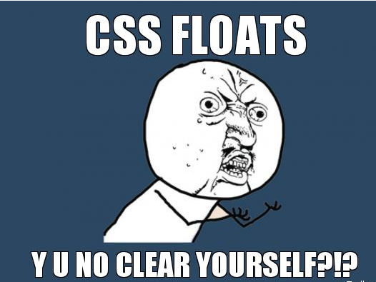
How to fix floats?

Slide 31
How to fix floats?
There are 2 ways to fix this:
Apply the CSS rule clear: both to an element after the floated content
Apply a CSS rule using the property overflow to the container

Slide 32
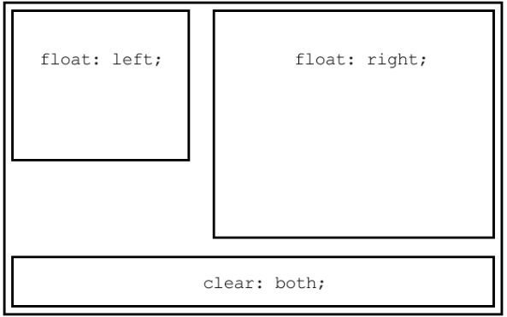
The CLEAR PROPERTY
The clear property is the sister property to float
It doesn’t do much until there are floated elements on the page
An element with clear applied to it will force itself below the floated element
Everything after that will be back in the normal flow
This “stretches” out the container and keeps it from collapsing

Slide 33
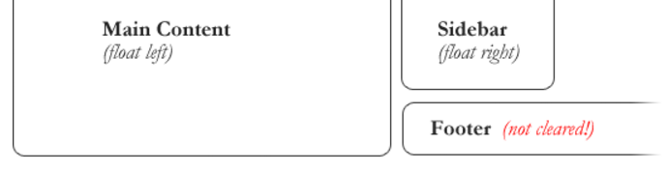
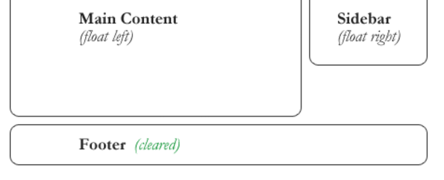
The CLEAR PROPERTY
The CLEAR PROPERTY
clear has similar values to float:
clear: none – the element does not move down to clear past floating elements (this is the default value)
clear: both – the element is moved down to clear both right- and left-floated elements

Slide 34
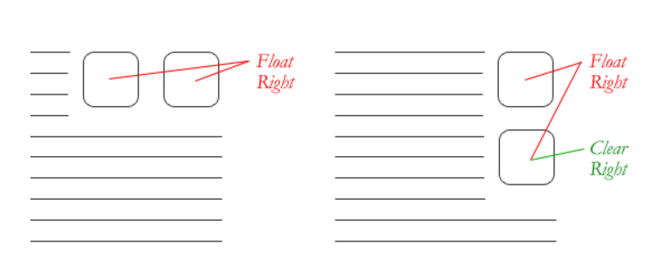
The CLEAR PROPERTY
The CLEAR PROPERTY
Sometimes, you want to let some content after a clear continue floating, but not other content:
clear: left – only clear left-floated elements
clear: right – only clear right-floated elements

Slide 35
The CLEAR PROPERTY
The CLEAR PROPERTY
So to solve our problem, you could add this empty div after the bio container:
<div style="clear: both"></div>
(We could apply the class to any type of element, but the benefit of using a div is that it has no style of its own.)

Slide 36
The overflow PROPERTY
The other way to force a container to expand around floated content is to apply a CSS rule with overflow to the container that the floated content is inside.
Any valid value for overflow will cause floated content to stretch out the container
Too complicated to explain, but it basically forces the container to re-assess the content inside it

Slide 37
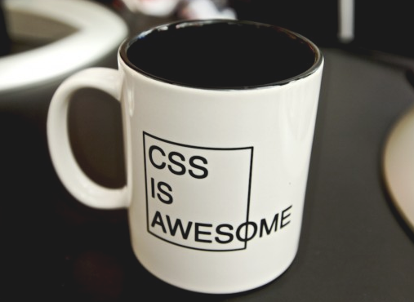
The overflow PROPERTY
The overflow PROPERTY
overflow is a CSS property that governs how content looks when it breaks out of its container.
By default, elements have
overflow: visible,
which means all content
is fully visible
Even if that means
overflowing its container!

Slide 38
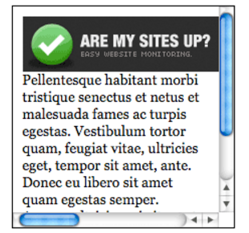
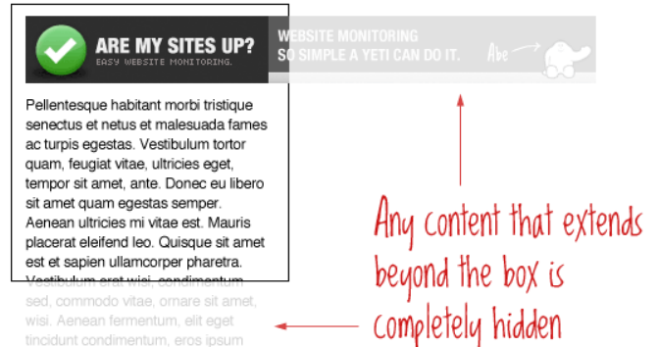
The overflow PROPERTY
The overflow PROPERTY
overflow: scroll makes scrollbars appear both horizontally and vertically…even if they don’t need to be there.
None of the content that would
overflow appears outside the box
overflow: hidden cuts off any content that “sticks out” of
its box
No way to scroll, so content is
no longer accessible

Slide 39
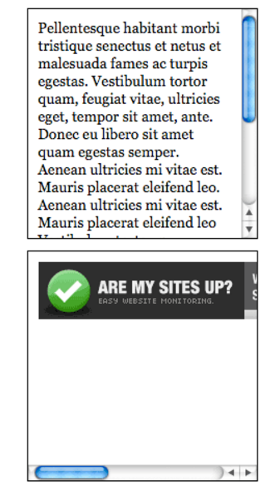
The overflow PROPERTY
The overflow PROPERTY
overflow: auto only adds scrollbars when the content requires it (which may mean no scrollbars are added at all)

Slide 40
The overflow PROPERTY
The overflow PROPERTY
So to solve our problem, you could add this CSS rule to the floated div:
.bio { overflow: visible; }

Slide 41

PRACTICE TIME!

Slide 42
ASSIGNMENT
Create a container that has an image floated to the side of some text.
Give the container a background color, gradient, or borders (to make sure floated content is really clearing properly and doesn’t just “look” cleared)
Try both techniques to force the container to expand around floated content
Apply box model properties like padding and margin so that your content looks nice

Slide 43
WEB LAYOUTS

Slide 44
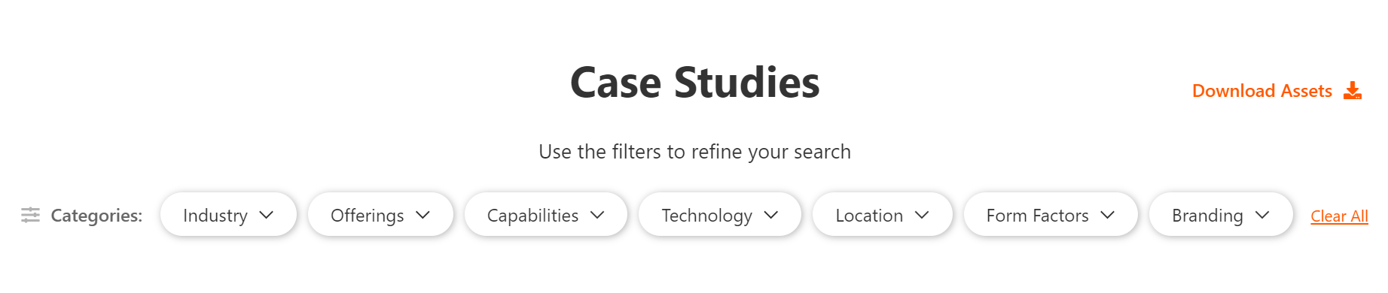
Layout with flexbox
Instead of using float to change the layout of your page, you can use display: flex
Adding display: flex to a container puts every direct child inside it one line

Slide 45
Layout with flexbox
<section class="filter-container">
<p><i class="fa fa-sliders-h"></i>Categories</p>
<div>
<div class="filter-button">Industry</div>
<div class="filter-button">Offerings</div>
<div class="filter-button">Capabilities</div>
</div>
<a id="clear" role="button">Clear All</a>
</section>

Slide 46
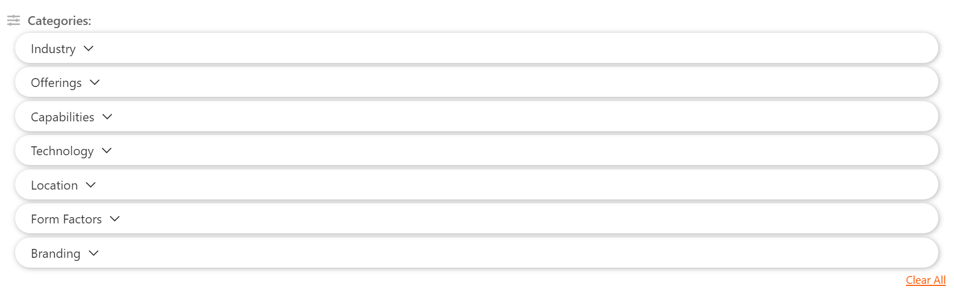
Layout with flexbox
With no flex at all, this is how that layout looks:

Slide 47
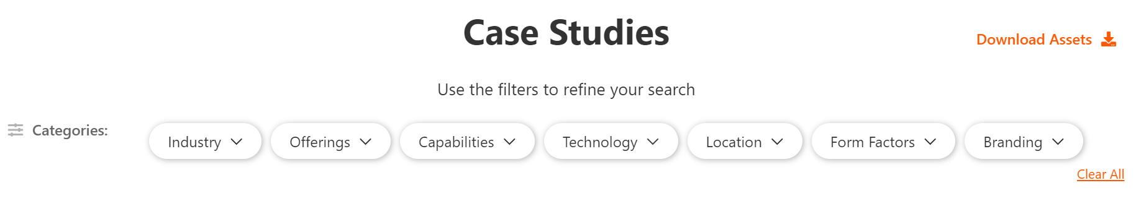
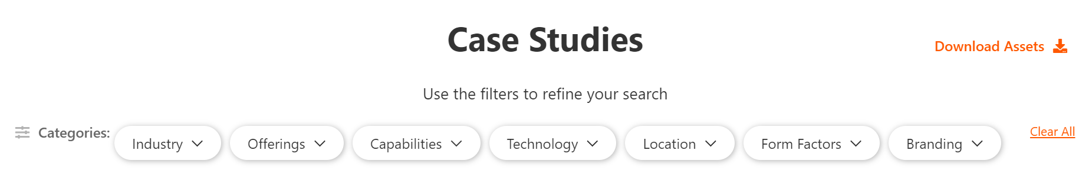
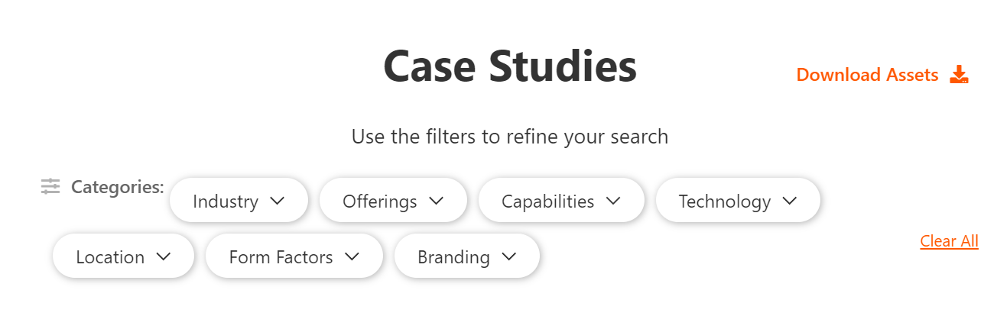
Layout with flexbox
Using float instead of display: flex

Slide 48
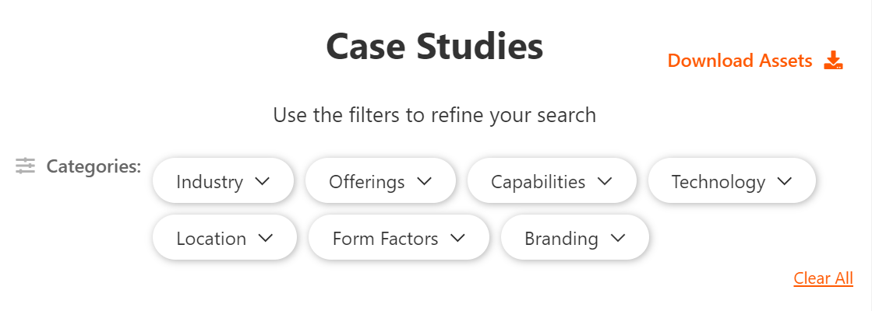
Layout with flexbox
.filter-container { display: flex; }

Slide 49

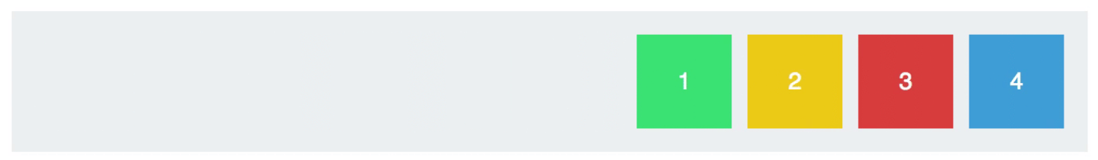
Justify-content
justify-content: controls how space is distributed between flex children horizontally
justify-content: center puts everything together in the middle
flex-start and flex-end move everything to either the beginning or end of the row

Slide 50
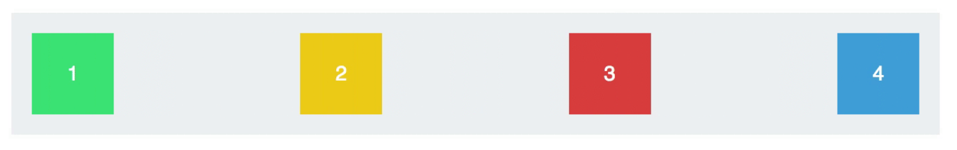
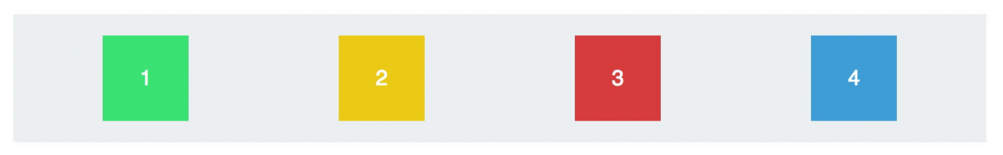
Justify-content
justify-content: space-between spreads all the items out evenly, with the first and last items flush against the ends of the container
justify-content: space-around distributes all the items with equal space around them

Slide 51
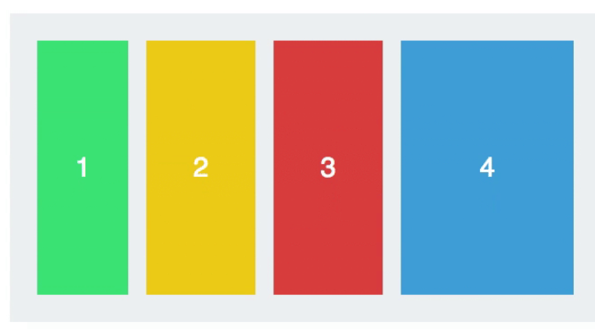
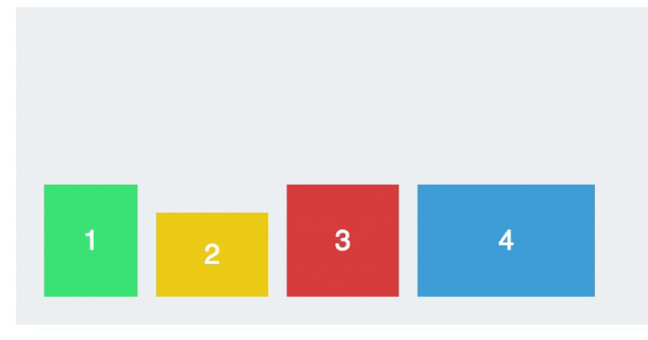
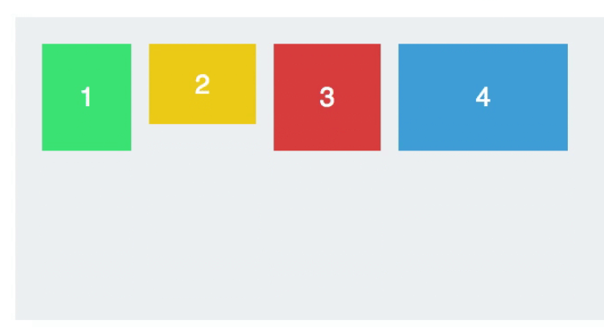
Align-items
align-items: controls how items are aligned relative to one another vertically
flex-start and flex-end align all children to either the top or bottom of their container
align-items: stretch makes all children stretch to the same height, (unless they already have a width defined by CSS)

Slide 52
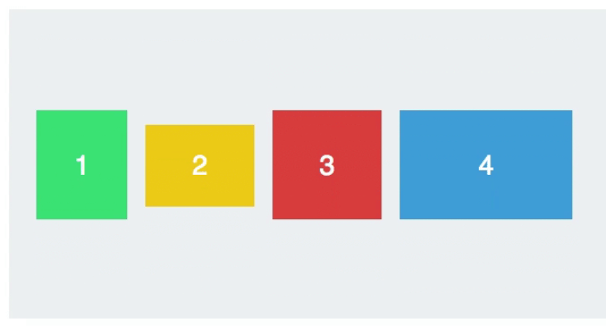
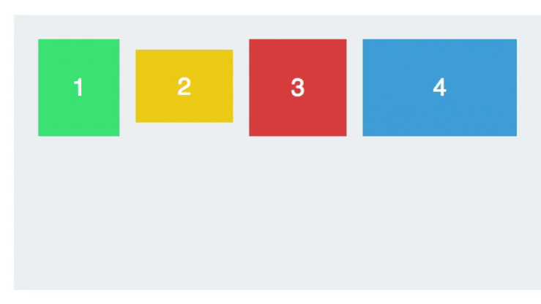
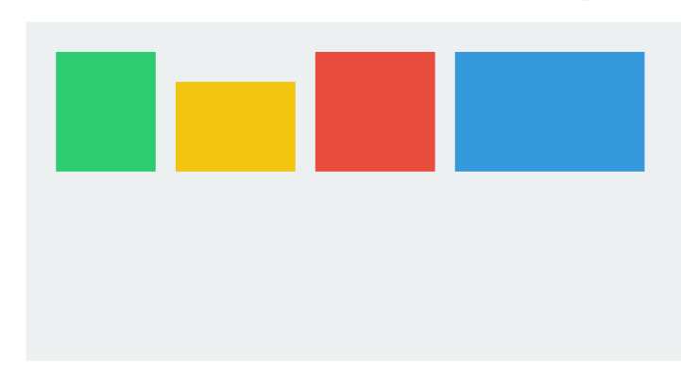
Align-items
align-items: center makes all children vertically centered, with equal space on top and bottom
align-items: baseline vertically centers children so that their text lines up
If there is no text, the bottoms of the items will be aligned instead

Slide 53
Layout with flexbox
Pros
Don’t have to worry about the clearing problem
Have better control of how children are aligned
Can use CSS to change the order in which children are shown
Cons
May require extra markup around flex children to prevent everything from becoming flex
May require extra markup to create a flex parent
Limited support in old browsers (Internet Explorer 9, 8, 7)

Slide 54
PRACTICE TIME!

Slide 55
ASSIGNMENT
Using last weeks last “match the comp” html file
Add a <main> element (if you don’t already have one) that surrounds your card markup, directly after <body>
Copy and paste the cards until there are at least 3
Note: if you added a height to the card you will want to remove it
Give main { display: flex; }
Play with flex properties until your cards look nice

Slide 56
Web fonts

Slide 57
Web fonts
Remember that font-family looks for a font installed on the user’s local machine.
body { font-family: Tahoma, sans-serif; }
If the Tahoma font isn’t found, the browser will default to a generic sans-serif font instead.
What if you want to use an interesting font that most people aren’t likely to have installed?

Slide 58
Web fonts
Web fonts
The absolutely easiest way to get custom fonts is to link to a CDN font stylesheet in the head of your page:
<link href="https://fonts.googleapis.com/css?family=Roboto" rel="stylesheet">
Remember that CDN means “Content Delivery Network”
A fancy way of saying a big, reliable company hosts the file for you
Google hosts 100s of free fonts

Slide 59
Web fonts
Web fonts
<link href="https://fonts.googleapis.com/css?family=Roboto" rel="stylesheet">
Once you include a font stylesheet from a CDN, you can refer to the font in a font-family rule, just like you would a web-safe font:
p { font-family: Roboto, sans-serif; }

Slide 60
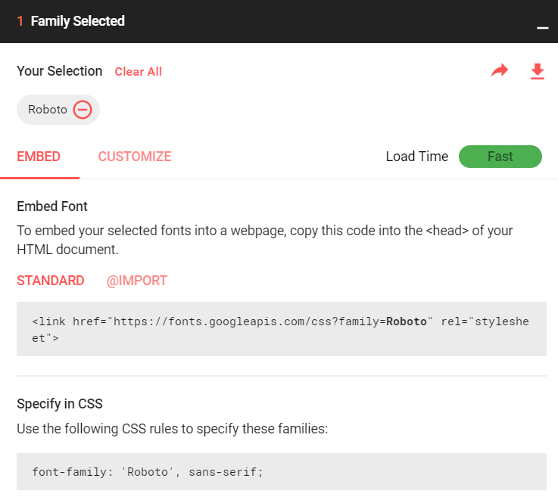
Web fonts
Web fonts
When you choose a font Google will tell you what name to use for it in your CSS

Slide 61
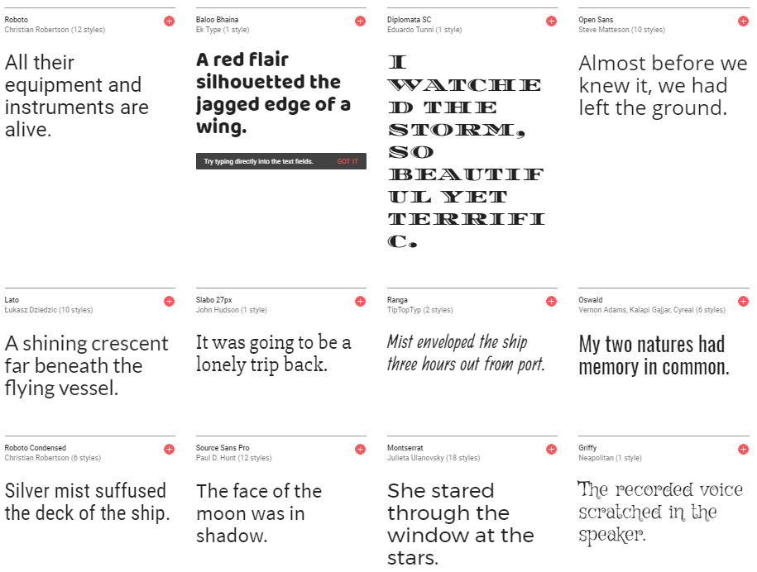
Web fonts
https://fonts.google.com/

Slide 62
Web fonts
Web fonts
cons
Relies on a 3rd party to provide assets
If the request times out, the font won’t download (so always provide fallbacks!)
pros
Extremely easy to get working
Possibility that user already has the font in their web cache due to visiting other sites that use the same font

Slide 63
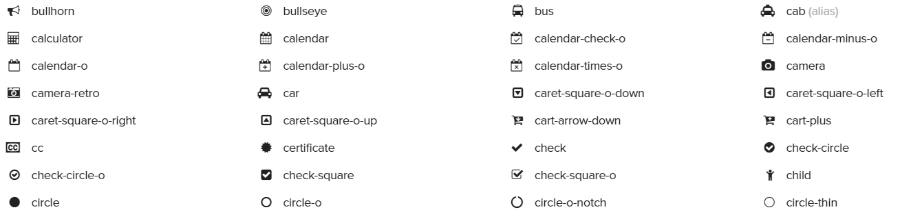
icon fonts
Font Awesome is a free icon font that is used in many real-world projects.
An icon font means letters have been replaced with vector images
So to color or re-size icons on your site, just use the CSS font properties we already learned.

Slide 64

Icon fonts
To quickly start using Font Awesome, add this stylesheet to the head of your page:
<link href="https://maxcdn.bootstrapcdn.com/font-awesome/4.7.0/css/font-awesome.min.css" rel="stylesheet">
Click an icon from the Font Awesome website, and copy the markup they provide, like:
<i class="fa fa-heart"></i>

Slide 65



Font AWesome
You can put a Font Awesome class on any element:
<span class="fa fa-paw"></span>
<i class="fa fa-cog"></i>
<h1 class="fa fa-thumbs-down"></h1>

Slide 66
Web fonts
The other way to ensure people see the correct font is to download the font onto their computer when they load your page.
You do this by first downloading a font into a folder on your website
There are free fonts available for download at websites like Font Squirrel or Font Spring
After you have a copy of the font you can share it just like any other media file on your website

Slide 67
Web fonts
Some considerations with hosting fonts:
May have to pay licensing fees – many fonts cost money
Some free fonts prohibit commercial use, or limit the number of pageviews

Slide 68
@Font-face
If you download a font that you want to use on your site, add @font-face before any other styles:
@font-face { font-family: MyWebFont; src: url('webfont.eot');
url('webfont.eot?#iefix') format('embedded-opentype'),
url('webfont.woff') format('woff'),
url('webfont.ttf') format('truetype'),
url('webfont.svg#svgFontName') format('svg'); }
(The good news is, font sites will provide this chunk of CSS for you to copy into your stylesheet!)

Slide 69
@Font-face
@Font-face
@font-face { font-family: MyWebFont; src: url('webfont.eot');
url('webfont.eot?#iefix') format('embedded-opentype'),
url('webfont.woff') format('woff'),
url('webfont.ttf') format('truetype'),
url('webfont.svg#svgFontName') format('svg'); }
Different browsers support different font filetypes
Modern browsers use woff
IE needs eot
Mobile devices need ttf or svg

Slide 70
PRACTICE TIME!

Slide 71
ASSIGNMENT
Find a free font from Google fonts and use it on your site by including the font stylesheet.
Apply the font to some (or all) elements on the page
Include the Font Awesome stylesheet:
<link href="https://maxcdn.bootstrapcdn.com/font-awesome/4.7.0/css/font-awesome.min.css" rel="stylesheet">
Display at least two different icons
Make them different sizes and/or colors
Bonus points: what other CSS can you apply to the icons?

Slide 72
Responsive
design

Slide 73
Mobile first
An important principle of responsive design is “Mobile First”
Both design and code should default to mobile resolution, adding progressive enhancements as the screen gets larger
One benefit of considering mobile first is that it trims down website content to its most vital elements
Mobile first = content first

Slide 74
Responsive != adaptive
Responsive design means that your design (and code) needs to function on a continuum of devices and screen sizes
Although you should make care that things look great at specific “breakpoints” (640px wide for iPhone 4/5, 768px for iPad), it’s just as important to make sure things look good at any resolution
Users resize their browser windows
Technology changes

Slide 75


Example – mobile

Slide 76

Example – desktop

Slide 77
Media queries
Media queries are used to apply different CSS to different devices.
Some things you can use a media query to detect:
The minimum or maximum screen height or width
Whether the screen is rotated (in “landscape view”)
If the page is being printed
If the user is on a touch screen device
The screen’s resolution

Slide 78
Media queries
Media queries have a different format than any other CSS we’ve seen so far
They always start with @media and have curly braces that contain all the CSS that applies to that media query rule
Multiple rules can be tested for, separated by and
@media (max-width: 480px) and (orientation: landscape) {
}

Slide 79
Media queries
To specify different styles when a webpage is being printed, use this media query:
@media print { }
This allows you to format your page so that it looks better on paper
Make the page full screen
Remove non-essential page elements (such as navigation links or social media icons)
Set font color to black and background color to white

Slide 80
Media queries
Most modern “mobile first” websites have CSS that applies to phone-sized screens first
Then, anything specific to bigger screens goes in media queries that test for a minimum screen width, like this:
@media (min-width: 768px) {
}

Slide 81
Media queries
/* CSS that is used for phones, and also
applies generally to all resolutions */
@media (min-width: 768px) {
/* CSS that is different for tablets */
}
@media (min-width: 920px) {
/* CSS that is different for desktops */
}

Slide 82
Media queries - example
h1 {
font-size: 12px;
color: gray;
font-family: sans-serif;
}
@media (min-width: 768px) {
h1 { font-size: 20px; }
}
@media (min-width: 920px) {
h1 { font-size: 25px; }
}

Slide 83
PRACTICE TIME!

Slide 84
ASSIGNMENT
Apply a media query to an element on your page so that it looks different when you resize your browser screen
Things to consider doing:
Make a two- or three-column layout only in desktop (for example a sidebar)
Make font sizes bigger for larger screen sizes, especially headings like h1 or h2

Slide 85
homework

Slide 86
HOMEWORK
Create a footer for your webpage
Add icons that link to your social media accounts using Font Awesome (or another icon library)
Remember you can use CSS to draw circles around them!
Use either float or flex to put your footer content in at least two columns
Include a copyright as the final row in the footer
Bonus: Switch to single-column layout for mobile only
Email me your files at beckjohnson@gmail.com

Slide 87
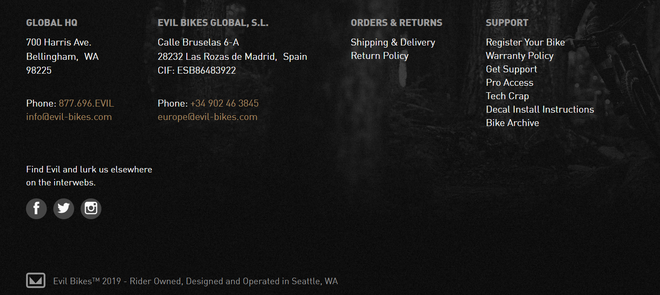
example
Add icons that link to your social media accounts (or to random celebrity accounts if you prefer to stay private)
Use either float or flex to make your icons look nice
Use either float or flex to put your footer content in at least two columns
Include a copyright as the final row in the footer
https://www.evil-bikes.com/

Slide 88
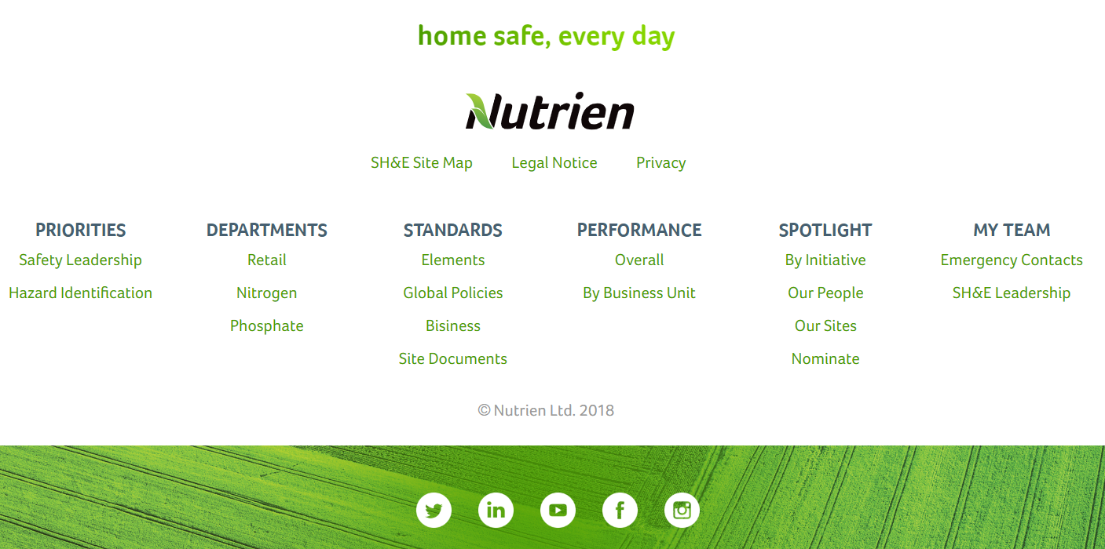
Example

Slide 89
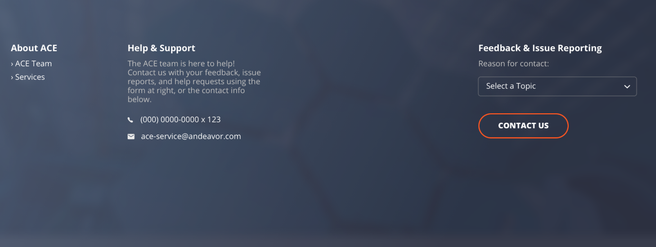
Example

Slide 90


“HOMEWORK”
I’ll send out a homework assignment next Wednesday via email so you guys don’t forget what you’ve learned!
Practice!
Optional: read chapters 15 and 17 of HTML and CSS: Design and Build Websites

